Slide 1
Transport of Carbondioxide
Dr.Deepa.G.S
Associate Professor
Dept of Physiology
SKHMC

Slide 2
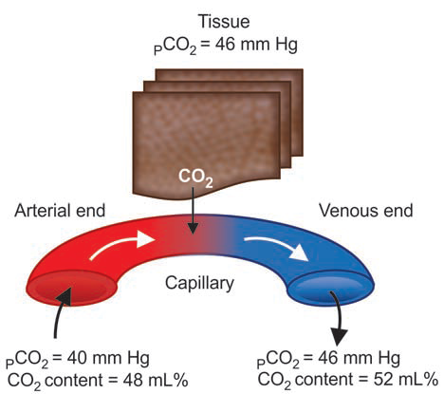
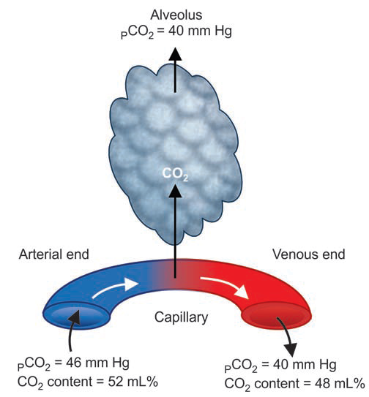
Exchange of Carbondioxide

Slide 3
Carbondioxide Transport
Carbon dioxide is transported by the blood from
Cells to the alveoli.
Carbon dioxide is transported in the blood in four
ways:
1. As dissolved form (7%)
2. As carbonic acid (negligible)
3. As bicarbonate (63%)
4. As carbamino compounds (30%).

Slide 4
Carbondioxide Transport
AS DISSOLVED FORM
3 mL/100 mL of plasma of carbon dioxide is transported as dissolved state.
It is about 7% of total carbondioxide in the blood.
AS CARBONIC ACID
Part of dissolved carbon dioxide in plasma combines with the water to form carbonic acid.
Transport of carbon dioxide in this form is negligible.

Slide 5
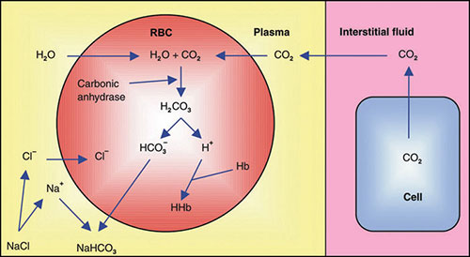
Carbondioxide Transport
AS BICARBONATE
About 63% of carbon dioxide is transported as bicarbonate.

Slide 6
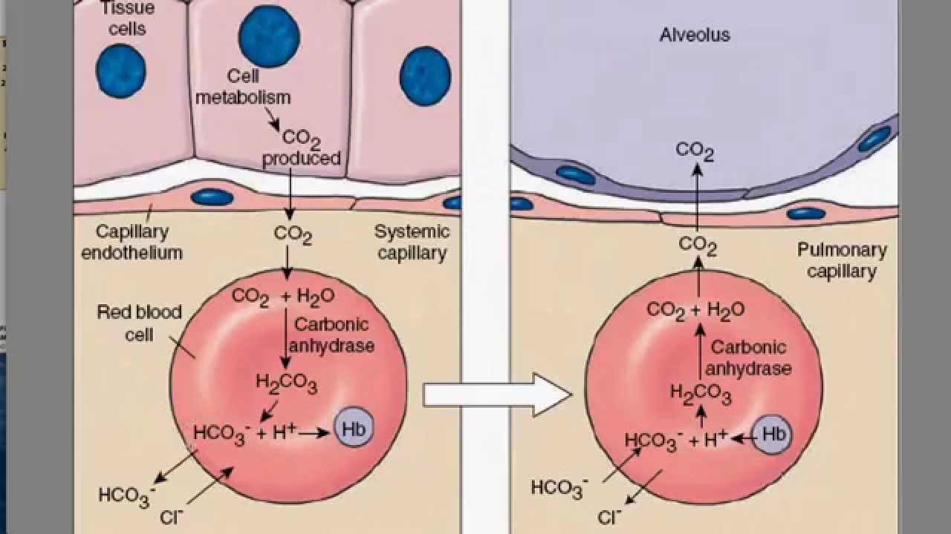
Carbondioxide Transport

Slide 7
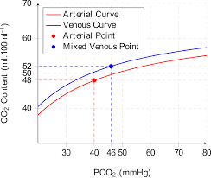
Carbondioxide dissocitaion curve

Slide 8
Factors affecting CO2 curve
Increase in body temperature-Shift to left
Decrease in Po2 shifts the curve to right

Slide 9
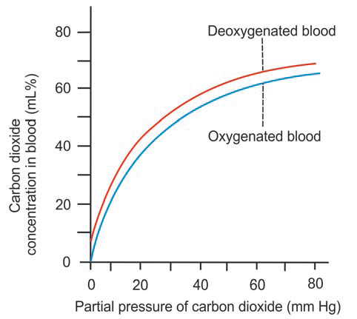
Carbondioxide dissocitaion curve

Slide 10
Haldane Effect
Combination of oxygen with hemoglobin displaces carbon dioxide from hemoglobin
Causes for Haldane effect
Due to the combination with oxygen, hemoglobin becomes strongly acidic.
It causes displacement of carbon dioxide from hemoglobin in two ways:

Slide 11
Haldane Effect
1. Highly acidic hemoglobin has low tendency to
combine with carbon dioxide. So, carbon dioxide is
displaced from blood.
2. Because of the acidity, hydrogen ions are released in excess.
Hydrogen ions bind with bicarbonate ions to form carbonic acid.
Carbonic acid in turn dissociates into water and carbon dioxide.
Carbondioxide is released from blood into alveoli.

Slide 12
Significance of Haldane effect
Haldane effect is essential for:
1. Release of carbon dioxide from blood into the alveoli of lungs
2. Uptake of oxygen by the blood.

Slide 13
Thank You

